Slide 1
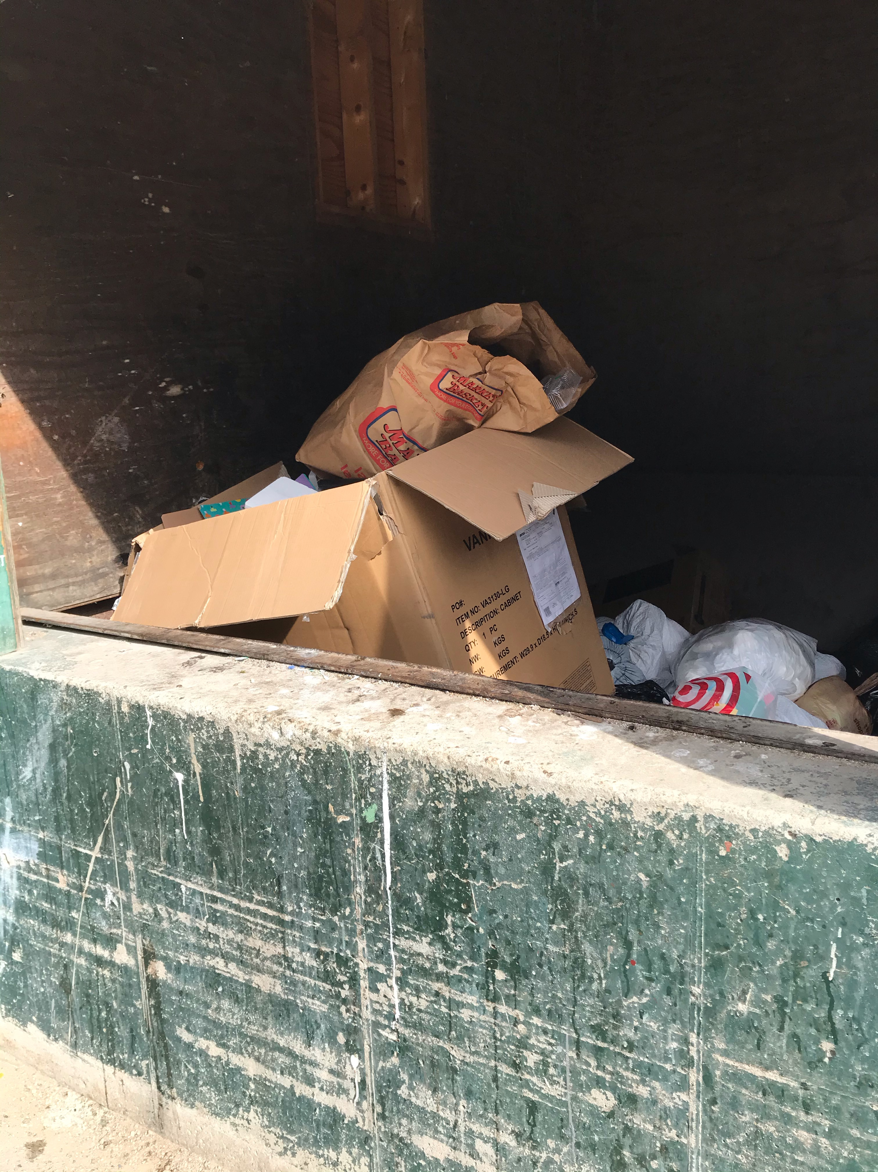
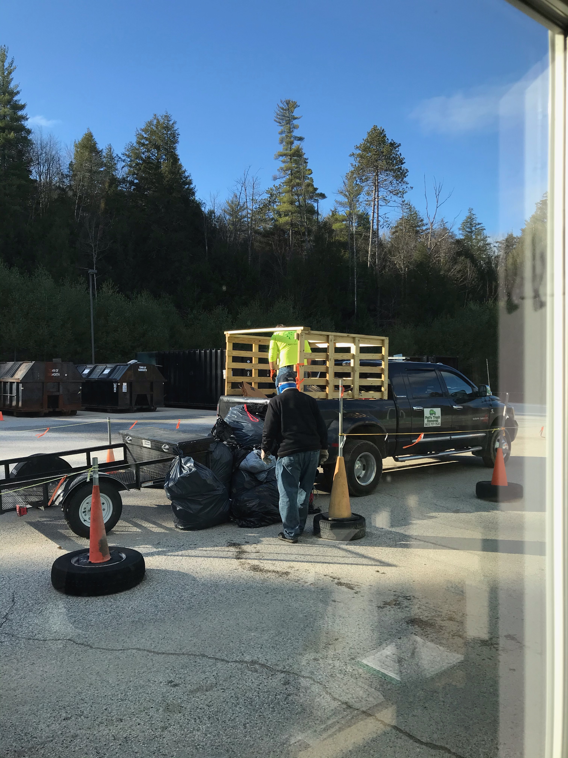
Transfer station improvement committee (TSIC)
Interim Report
to the
Tamworth Select Board
December 2, 2021

Slide 2
Contents
What we recycle, and where all our trash goes
How much it costs and how much could we save
TSIC research on options
No change (what we’re doing now)
No recycling No brush
Regional cooperation
Single stream recycling
Increase source-separated recycling capacity
Comparisons
Proposed next steps

Slide 3
Break down of Tamworth’s Municipal waste at the transfer station
EPA’s Percentages in the Waste Stream Tonnages in our MSW
*The 12.1% yard trimmings are not allowed in the MSW
Tamworth MSW may vary from the EPA percentages
Notes:
About 40% of Tamworth’s waste is estimated to be recyclable paper & OCC, plastic, and glass. We currently only recycle 8 percent.

Slide 4
Where did OUR TRASH go in 2020?
MSW 973.35 tons in a landfill in Rochester NH
Demo 323.73 tons in a landfill in Rochester NH
Glass 44.53 tons to PGA in Rochester NH
OCC 37.53 Tons to Recycle in Rochester NH
Alum and Tin 3.88 tons to Ricker Salvage in Tamworth NH
93% goes in the landfill
Other Items handled at the transfer station:
Heavy Metal, Tires, Electronics, Refrigeration, Brush
Notes:
Consider talking about: The C&D Demo goes in a landfill
In 2020 numbers:
Total MSW 1060 we removed 87 tons for recycling or cost savings or 8.25% C&D 323.73 tons
Should Demo come out of this picture as it will not change, if not should we also talk about the other items collected at the transfer station tires, electronic, heavy metal.

Slide 5
What we remove from the MSW
Item | Removed | Left |  | Comment
Glass | 44.52 | 0% |  | Cost to ship for PGA $98.02 per ton
OCC and Paper | 37.82 | 94% |  | Cost $122.16 per ton to ship plus $45 handling fee, small rebate
Aluminum | 3.08 | ? % |  | Revenue $1,116.71
Steel can | 0.80 | ? % |  | Revenue $35.68
Everything that we can remove from the MSW and find a market for or a less expensive way to dispose of helps.
The big three are; OCC and paper @ 23.1%, Food waste @ 21.6%, and plastic @ 12.2% Totaling 56.9% of the MSW
Pricing is NRRA October 2021 monthly average:
 |  | Aluminum | OCC |  | Steel Cans |  | Mixed Paper |  | Glass
 | Baled | $1,040 | $173 |  | $112 |  | $60 |  | n/a
 | Loose | $860 | ($122) |  | $62 |  | $37 |  | ($98)
 | In MSW | ($106) | ($106) |  | ($106) |  | ($106) |  | ($106)

Slide 6
Hauling & tipping costs with waste management Expires October 31, 2024
Cost in the first year of the new 3-year contract for hauling and tipping: (4% increase each year)
MSW cost $105.85 per ton
C&D /Demo cost $140.63 per ton (Users of the C&D / Demo pay a user fee.)
Glass cost $98.02 per ton (This saves $7.83 per ton.)
OCC cost $122.16 per ton (Plus a $45 handling fee per load),(There is some rebate back, based on market price.)

Slide 7
Tamworth transfer station costs are increasing and the landfill is reaching capacity
4% increase in costs per year for the next 3 years

Slide 8
2020 Transfer Station Costs

Slide 9
Tamworth Could save money through an investment in increased marketing of recycled products
2020 Data | Tamworth in 2020 | Tamworth @ 35% | Walpole In 2020 | Ossipee In 2020
Population | 2,812 | 2,812 | 3633 | 4,384
Total Tons of Household Trash | 1060 | 1060 | 939 | 1,517
Tons Recycled | 87 | 371 | 220 | 129
% Recycled | 8% | 35% | 23% | 8%
Avoided Landfill Costs | $9,209 | $39,165 | $28,750 | $13,895
Recycling Revenue | $1,152 | $20,000 | $43,500 | $17,967
Net Savings | $10,361 | $59,165 | $72,250 | $31,862
Nationally, communities recycle about 35% of their trash on average in all systems.
If Tamworth increased recycling to 35% and added bailing and storage capacity, we could save $59,165 per year
That is $591,650 over 10 years
Notes:
This assumes that the cost stay the same
Tamworth can do better than the national average witch includes all types of systems single stream and source separation, and no recycling at all.

Slide 10
Alternatives: * No change * Zero recycling * Regionalization * Single Stream Recycling * Full Recycling * (All options include adding water and septic in 2022)
TSIC asked to research how to improve transfer station
Notes:
Consider talking about:
Supply
Government-mandated demand

Slide 11
No change from today
Goal: Business as usual
Costs continue increasing
The landfill is reaching capacity
We will need to replace the old compactor and ideally add a second one and scales in the coming years: $250k
The recyclables market is the best it has been in years – Tamworth is missing out on savings because we cannot bale and market our recyclables
Notes:
Consider talking about:
Quality of recyclate
Quality recyclate action plan (Scotland)

Slide 12
Zero recycling No Brush
Goal: Reduce costs
Just do what’s required by law
All household waste goes to landfill
Demo C&D separated out to landfill
Replace old compactor: $50k
Decrease labor: $40k annual savings

Slide 13
regional cooperation
Goal: Increase recycling at lower cost through through regional cooperation
TSIC reached out to six communities: Madison, Sandwich, Ossipee, Moultonborough, Freedom, and Effingham
Communities responded that they are not interested in collaborating. Reasons cited:
Distance to travel
Difficulty of forming a regional solid waste district
Are currently meeting own needs adequately
Not a viable option at this time

Slide 14
Single stream recycling
Goal: Reduce costs a bit with simplified recycling
Residents put all recyclables in one bin
Two compactors and scales: $250k
Send recyclables to facilities that separate them
Costs about $66* per ton more than our MSW
Estimated additional cost of 371 tons of recyclables $24,486
* average for Moultonborough and Sandwich

Slide 15
Increased recycling capacity
Goal: Reduce costs and generate revenue through increased recycling
Construct facility and purchase equipment to separate, bale and store multiple recyclable commodities, plus truck scales to maximize revenue to town: $1,566K
Revenue from sale of baled recyclables: $20k
Savings by diverting from landfill: $39k
Net annual cost savings: $59k
Notes:
Three person should be able to handle the trash

Slide 16
Comparison of options
 | No Change | No Recycling | Regional Cooperation | Single Stream | Increased Recycling to 35%
Capital investment in:
Water & Septic | $150,000 | $150,000 |  | $150,000 | $150,000
Replacement MSW Compactor | $50,000 | $50,000 |  | $50,000 | $50,000
Scales | $100,000 |  |  | $100,000 | $100,000
Second Compactor |  | $150,000 |  | $150,000
Recycling facility |  |  | $2,000,000 |  | $1,266,000
Total investment | $300,000 | $350,000 | $2,000,000 | $450,000 | $1,566,000
Annual operating costs | $337,000 | $297,000 |  | $337,000 | $337,000
Avoided Landfill Costs | $9,209 | 0 |  | ($24,486) | $39,165
Recycling Revenue | $1,152 | 0 |  |  | $20,000
Net Cost (2020 data) | $326,976 | $297,000 | Unknown | $361,486 | $277,835
Net Savings | $0 | $40,000 | Unknown | ($24,486) | $59,165
The key to saving money is not to put items that can be recycled in the MSW
Finding alternate less expensive Disposal costs for other items

Slide 17
Increase recycling & market baled Recycled products
How can
Tamworth
save money ?

Slide 18
USDA GRANT
Eric Law from the USDA said,
“ If this project is necessary and inevitable, there is no better time than now to go for the grant.”

Slide 19
Proposed next steps
Water, sewer and bathroom improvements in 2022 with ARPA funds (phase I)
Seek USDA grant for $495,600 which is 35% of total facility costs, including design, environmental review, equipment
Seek additional grants to help cover the costs, such as NH The Beautiful grant for signage
Fund remaining costs $822,000 from taxes $273,400 in each year 2022, 2023, and 2024 (current bond payments for school $239,000 expire in 2022 and the landfill $72,000 expire in 2023) (There is $100,000 in a Capital Reserve)
Construct recycling facility with equipment at transfer station (phase II) completion in 2024

Slide 20
Requests of Select Board
Approve effort to seek grant funding
Support for collecting information needed
Approval to initiate environmental review now for grant requirements
Approval to advance other grant requirements

